Slide 1
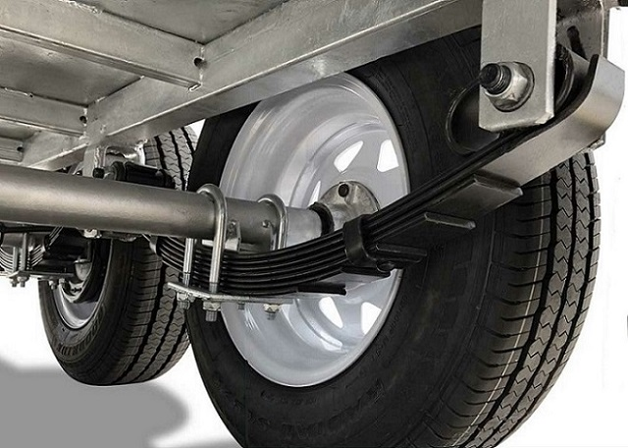
MECHANICAL VIBRATION PROJECT
Modal Analysis of Leaf Spring Using Composite Materials
MECHANICAL ENGINEERING , IIT GUWAHATI
Group-12
1) NIHAL KUMAR (234103424)
2) DEEPAK KUMAR (234103414)
3) MAHESWARA REDDY (234103422)

Slide 2
INTRODUCTION
Leaf Springs are widely used in the automobile industry due to its high load bearing capacity and low manufacturing cost
Use of composite materials has gradually increased in the automobile industry due to its light weight and high strength to weight ratio
This work investigates the feasibility of using a low cost and light weight material for automobile leaf springs.
We compare conventional steel EN45 leaf spring with several composite leaf springs such as Carbon-Glass Epoxy, Kevlar-Epoxy and Isotropic Aluminium 6061 based on their natural frequencies

Slide 3
METHODOLOGY
Reverse engineering
(Take dimension from Existing leaf spring model)
CAD modelling using CATIA V5 and FEA in ANSYS Workbench
Theoretical Validation using Rayleigh Ritz Method
Results Comparison between
• EN45 Steel
• Carbon/Glass Epoxy
• Isotropic Aluminum 6061
• Kevlar/Epoxy
Modal Analysis:
Obtain Natural Frequency and Mode Shapes for each Material Property

Slide 4
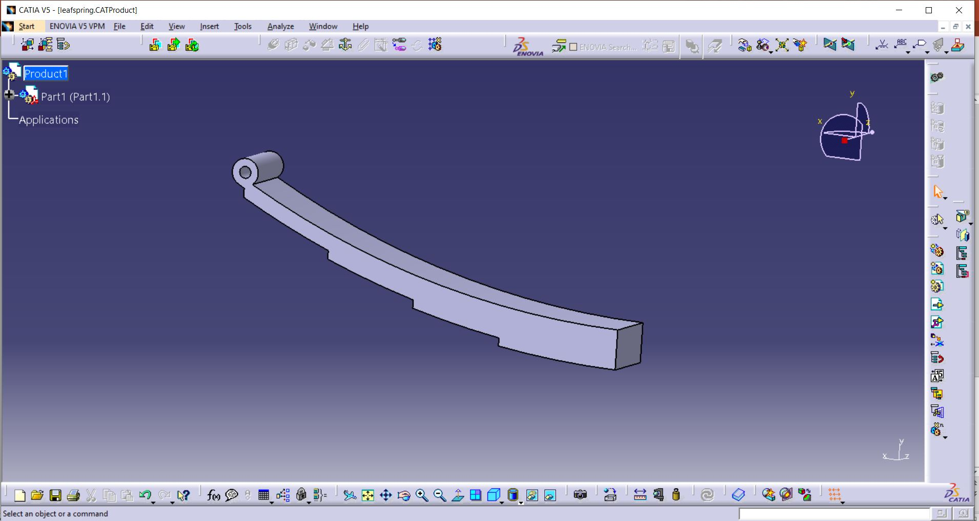
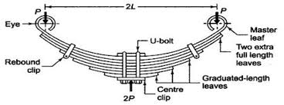
CAD MODELLING
Parameter | Value
Total length of the spring | 1020 mm
No. of full length leaves | 2
No . Of graduated leaves | 3
Thickness of leaves | 10 mm
Width of leaves | 80 mm
Radius of Master Leaf | 1098 mm
Length of leaves in increasing order | 315 mm,550 mm, 785 mm,1020 mm,1020 mm
Bandwidth | 80 mm
CATIA V5 was used for CAD modelling
Dimensions were taken from one of the research papers and suitable assumptions were done for bolt dia

Slide 5
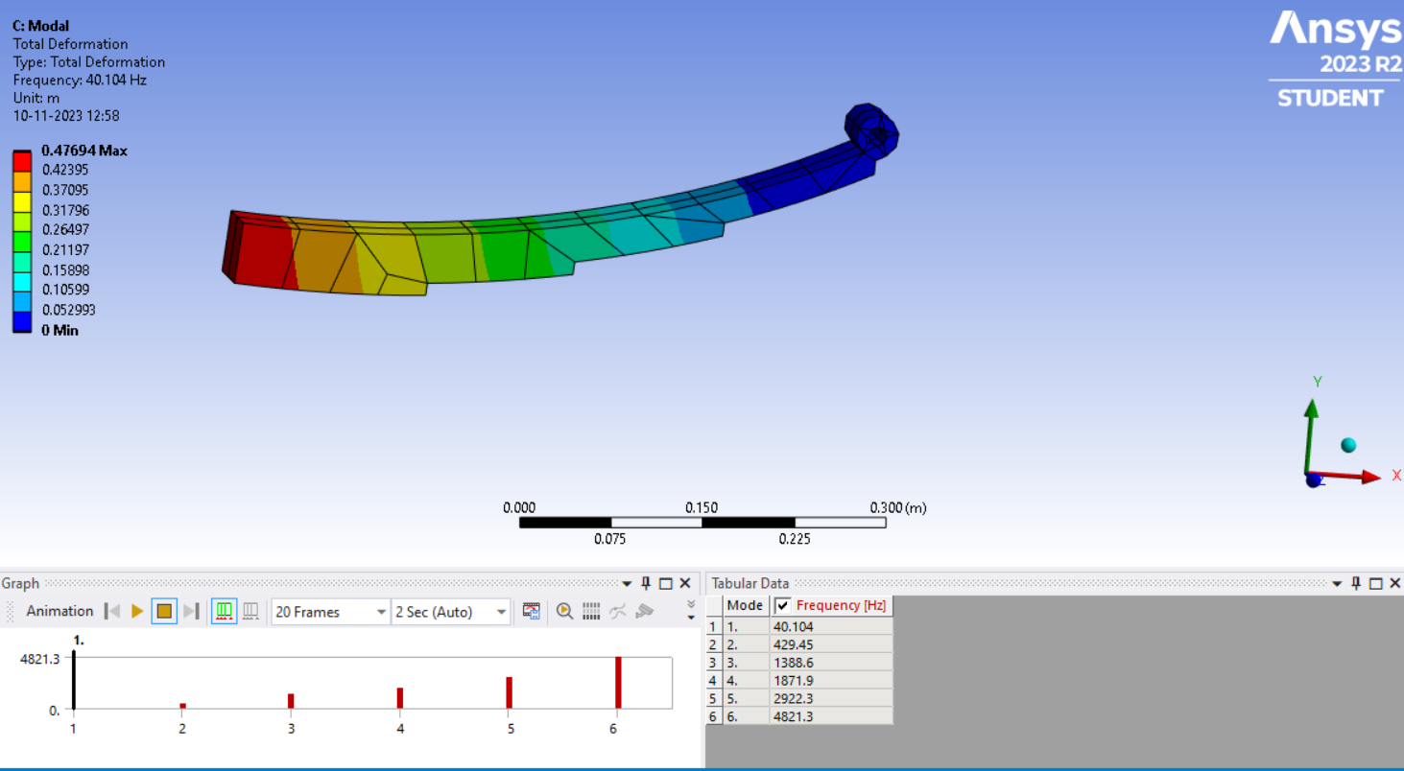
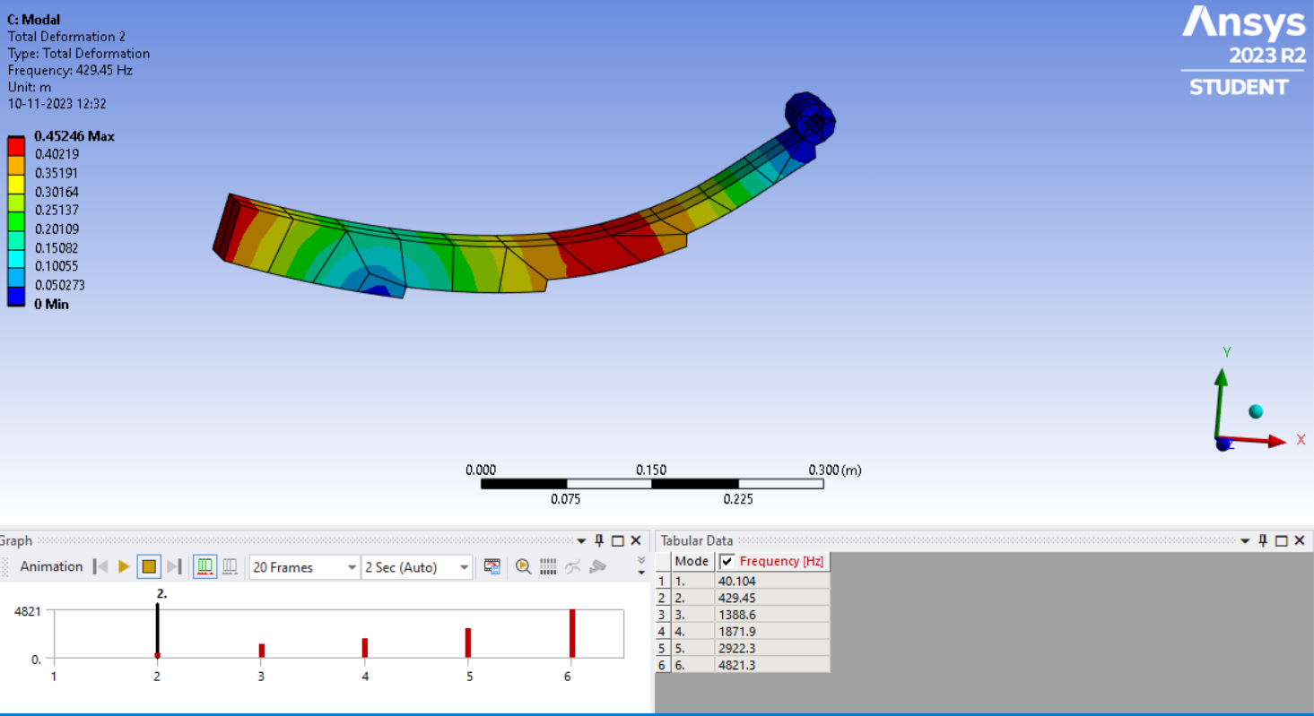
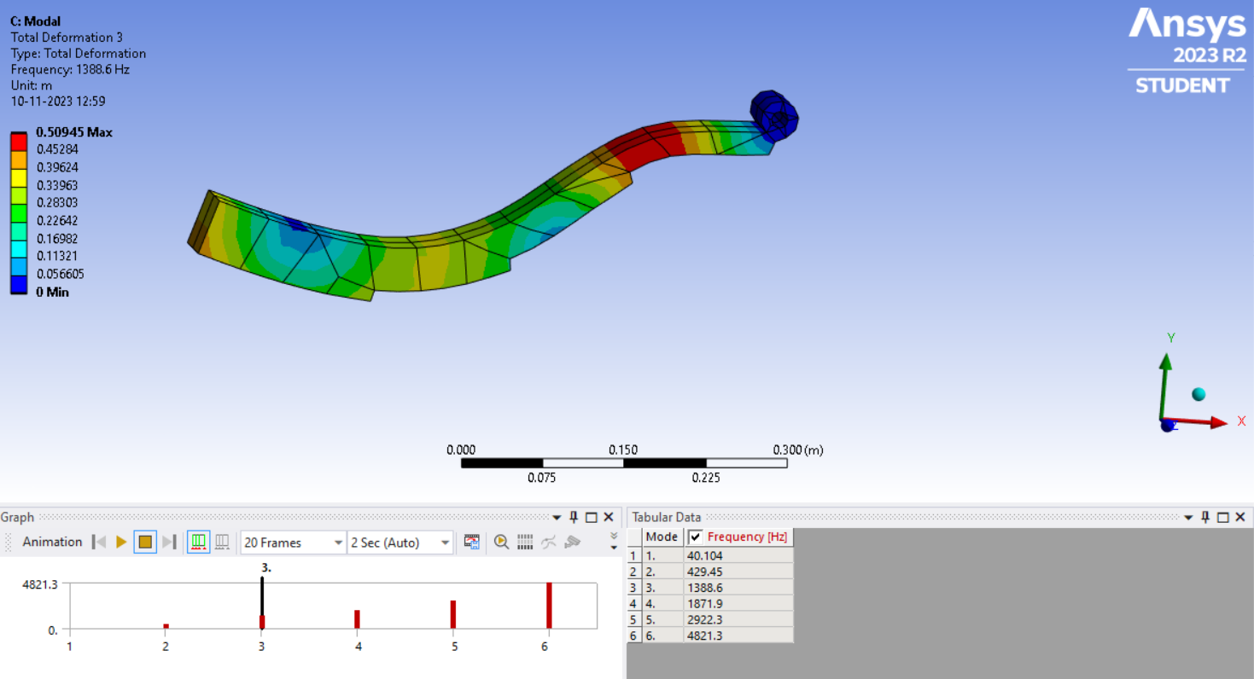
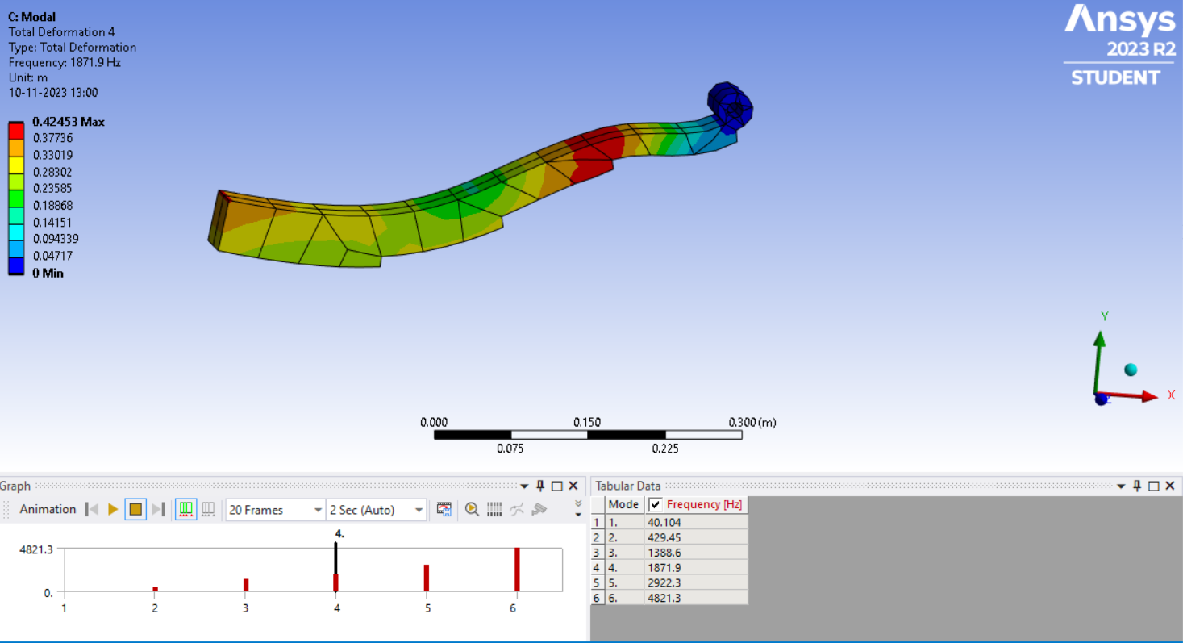
MODAL ANALYSIS

Slide 6
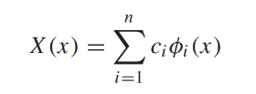
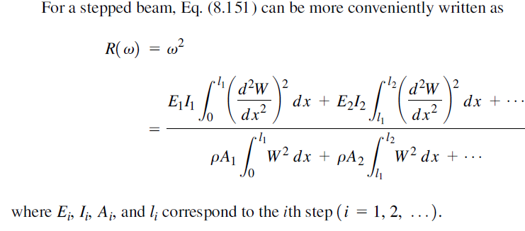
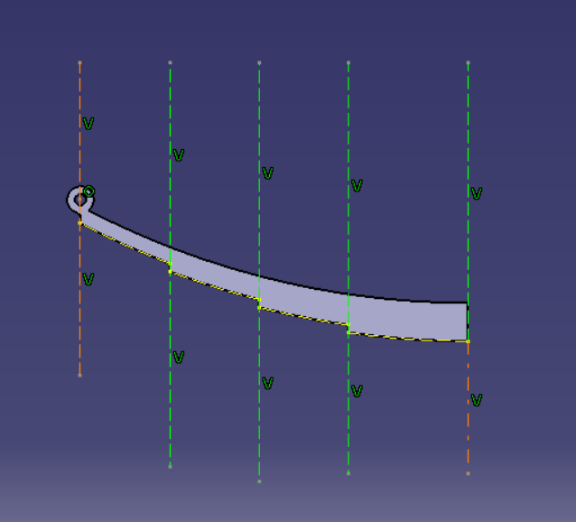
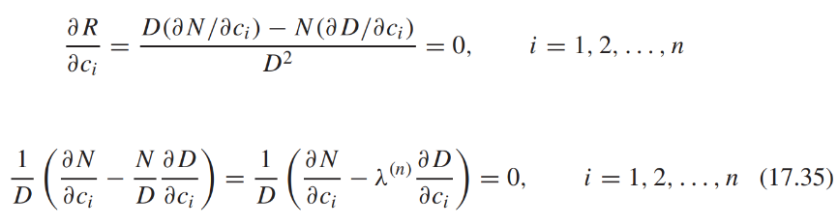
THEORETICAL VALIDATION
Rayleigh Ritz Method was used for theoretical validation
X=0 was taken at the eye
X=c1(x/l)²+c2(x/l)³+c3(x/l)⁴
Rayleigh Quotient, R, was calculated using stepped beam formula
Stepped beam formulation of spring into 4 elements

Slide 7
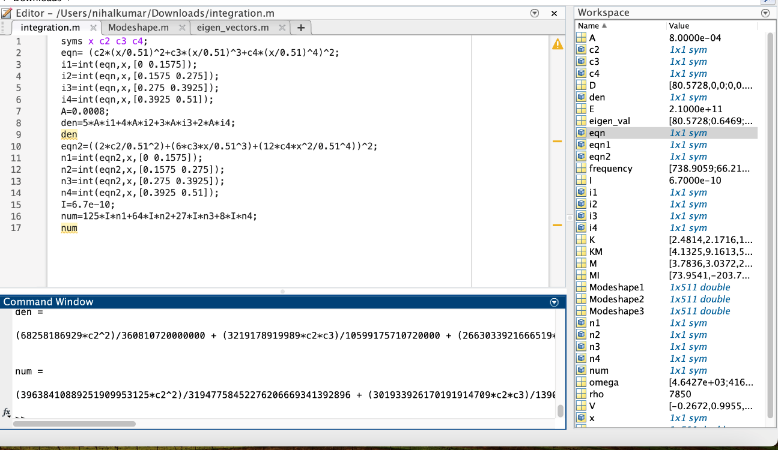
THEORETICAL VALIDATION
MATLAB code for obtaining R using integration

Slide 8
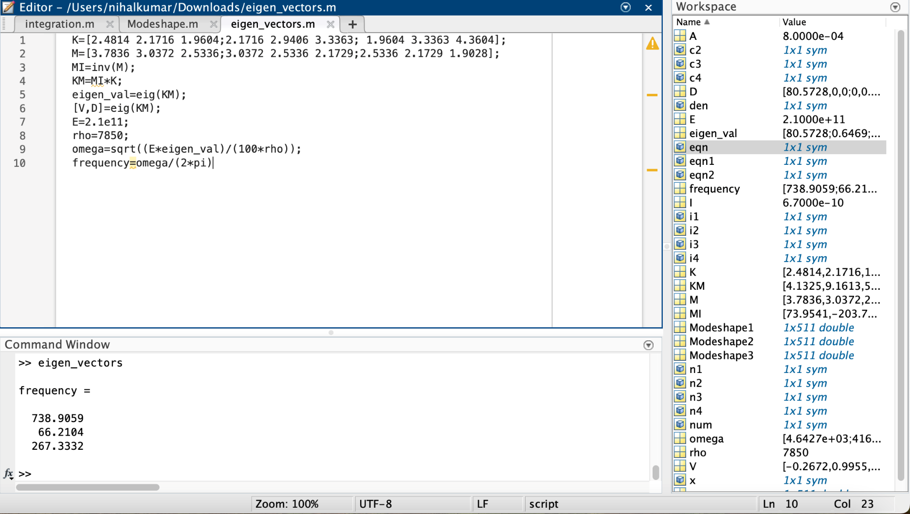
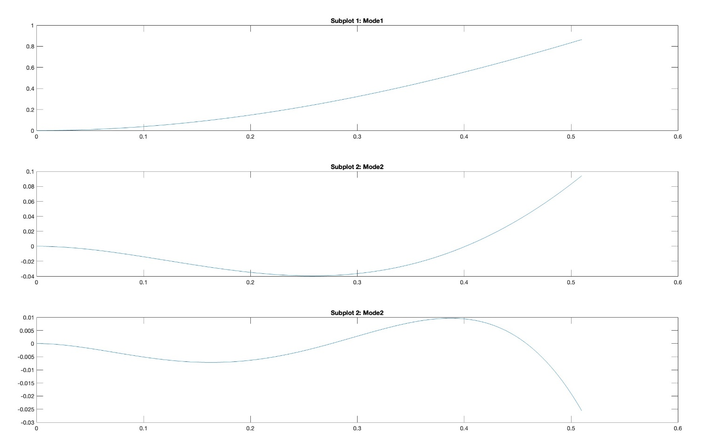
THEORETICAL VALIDATION
Equation in Matrix form was obtained
[K]{c}=λ[M]{c}
where λ=100*ω²*ρ/E
ρ-density of the material
E- Young’s Modulus
Eigen values of M⁻¹K matrix gave the values of
λ and corresponding eigenvectors which were
used to calculate natural frequency and
modeshapes respectively for different materials
by changing the values of density and young’s
modulus.
MATLAB code for calculating eigenvalues and eigen vectors
Modeshapes For Steel Material

Slide 9
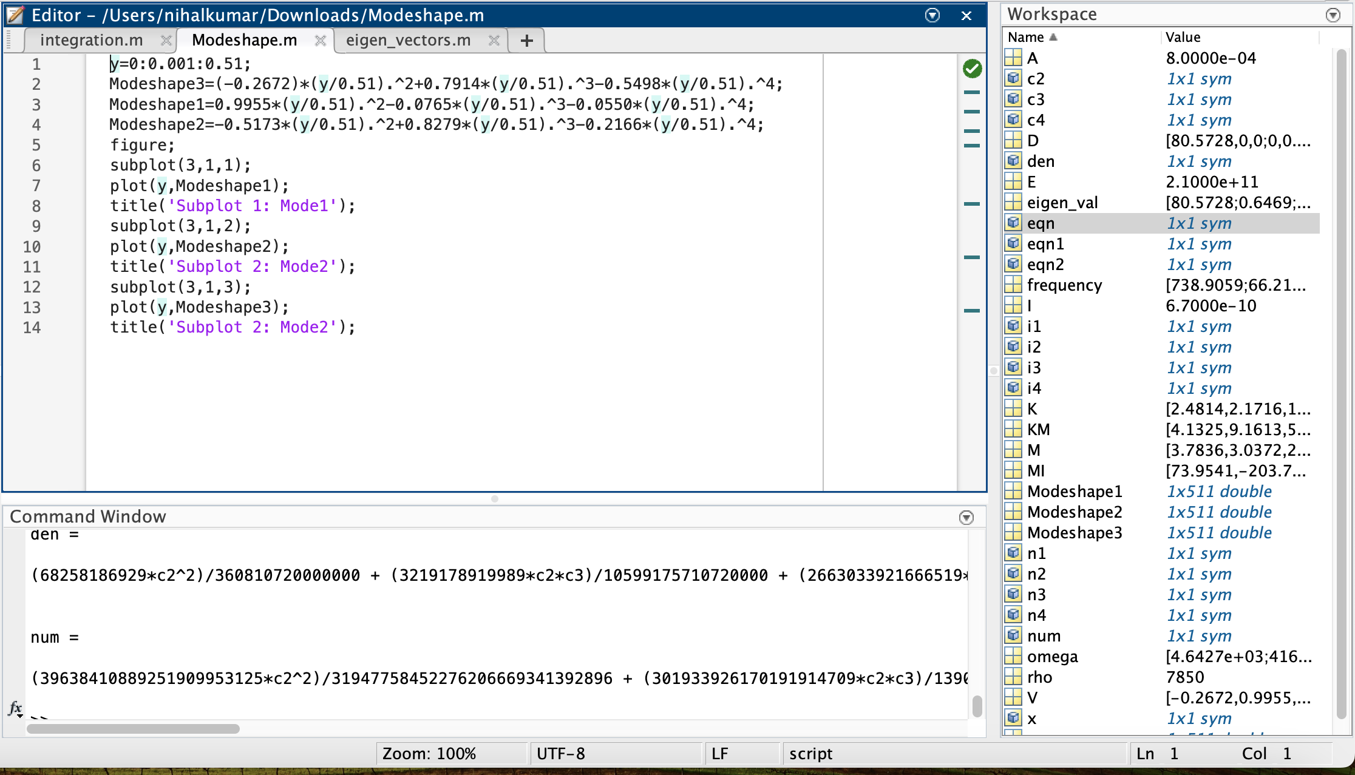
THEORETICAL VALIDATION
MATLAB code for plotting Modeshapes

Slide 10
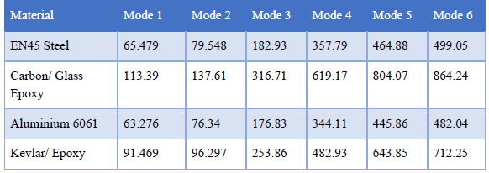
THEORETICAL VALIDATION
 | Frequency(Hz) | Frequency(Hz) | Frequency(Hz) | Frequency(Hz)
Mode | Steel | Kevlar Epoxy | Carbon/Glass Epoxy | Isotropic Aluminium 6061
1 | 66.2 | 106 | 114.6 | 63.77
2 | 267 | 427 | 462.7 | 257.48
3 | 738 | 1180 | 1278.9 | 711.69
Material | Density (Kg/m³) | Reduction in Weight
Steel EN45 | 7850
Kevlar Epoxy | 1402 | 82.14%
Isotropic Aluminium 6061 | 3783.6 | 51.80%
Carbon/Glass epoxy | 1672 | 78.70%
MATLAB code for calculating eigenvalues and eigen vectors
Paper Data

Slide 11
CONCLUSIONS
Through modal analysis it is observed that Carbon/Glass Epoxy and Kevlar/Epoxy show higher first natural frequencies due to its greater stiffness and low mass properties. This is better as greater excitation frequency is required to cause structural damage to the Carbon/Glass Epoxy and Kevlar/Epoxy Leaf spring
This benefits the automobile as the mechanical efficiency and performance is improved, Fuel consumption is lesser therefore overall fuel economy increases.

Slide 12
REFERENCES
Static and Dynamic Analysis of Automotive Leaf Spring: A Comparative Study of Various Materials Using ANSYS
Modal and Harmonic Analysis of Leaf Spring Using Composite Materials-Putti Srinivasa Rao, Revu Venkatesh
MODAL ANALYSIS OF COMPOSITE LEAF SPRING USED FOR MEDIUM UTILITY VEHICLE.Yogesh Y. Kamble,Prof. Dr. S.H.Sawant
Critical Analysis of Vibration Behaviourof Multi-Leaf Spring under Loading Condition by ANSYS Software”,Karan K. Sharma, Arshad Rashid, Saiprasad Mandale
Modal Analysis of Mono Leaf Spring Using Analytical, F.E.A (Pro-e Mechanica) and Experimental (Vibration Shaker) Approach. Prof. K. K. Sharma,Khan Moin,Abdul Ashish, Choudhri Ibrahim, Rehan Ansari
S.S. Rao-Vibrations in continuous systems

